Slide 1
RBR CTD 자료처리 프로그램 사용법

Slide 2
배경 및 필요성
금년 SBE CTD 수요 급증 및 보유량 부족으로 한국연안 해류조사 시 RBR CTD 사용 빈도 증가
SBE CTD와 달리 RBR CTD에 대한 자료처리 방법 및 도구가 없어 발생하는 문제점 개선 필요

Slide 3
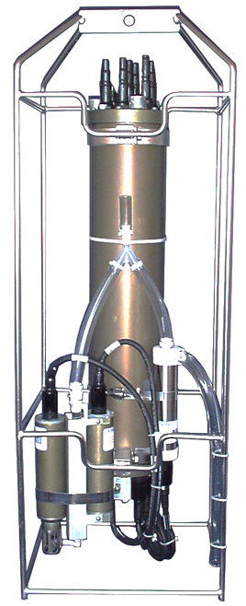
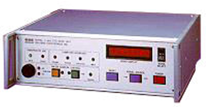

각각의 특징 비교
 | SBE 911+ | RBR Concerto
Sampling Rate | 24Hz | 2~32Hz
메모리 | X | O
실시간 | O | X
크기 | 대형 | 소형
편의성 | 복잡 | 간단
확장성 | 높음 | 낮음
정확도 | ±0.0003 S/m, ±0.001 °C, ±0.015% | ±0.003mS/cm, ±0.002°C, ±0.05%
가격 | 고가 | 저렴

Slide 4
(py)RSKtools
RBR에서 제공하는 CTD 자료처리 도구, MATLAB, python 버전 제공(https://rbr-global.com/support/matlab-tools/)
https://docs-static.rbr-global.com/pyrsktools/index.html
https://www.youtube.com/watch?v=OX5X1G1qWzU

Slide 5
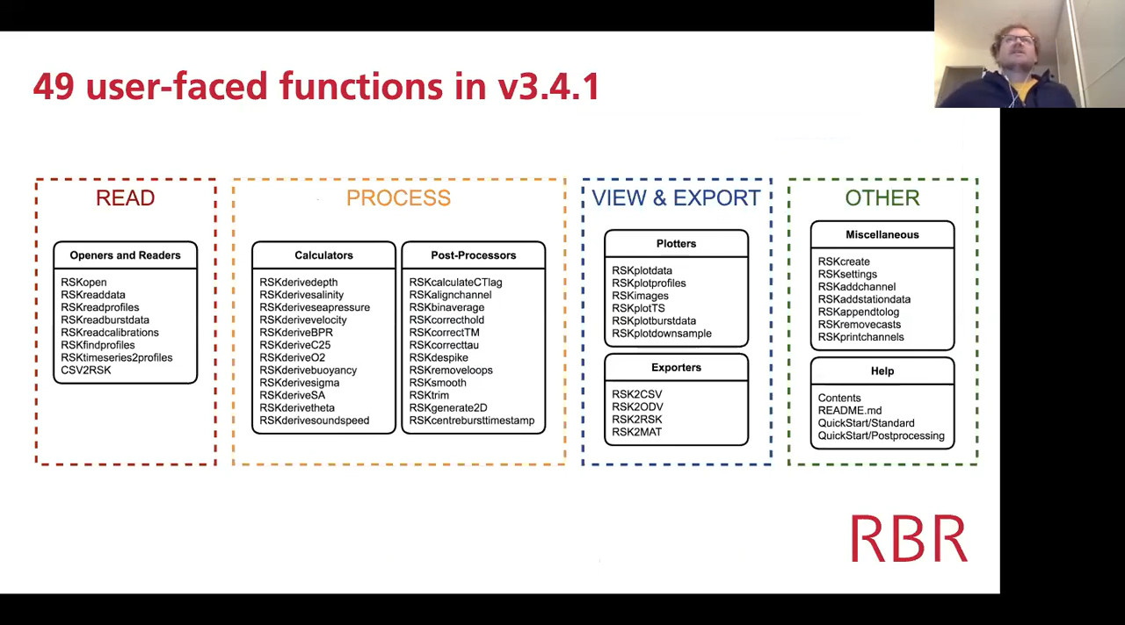
(py)RSKtools

Slide 6
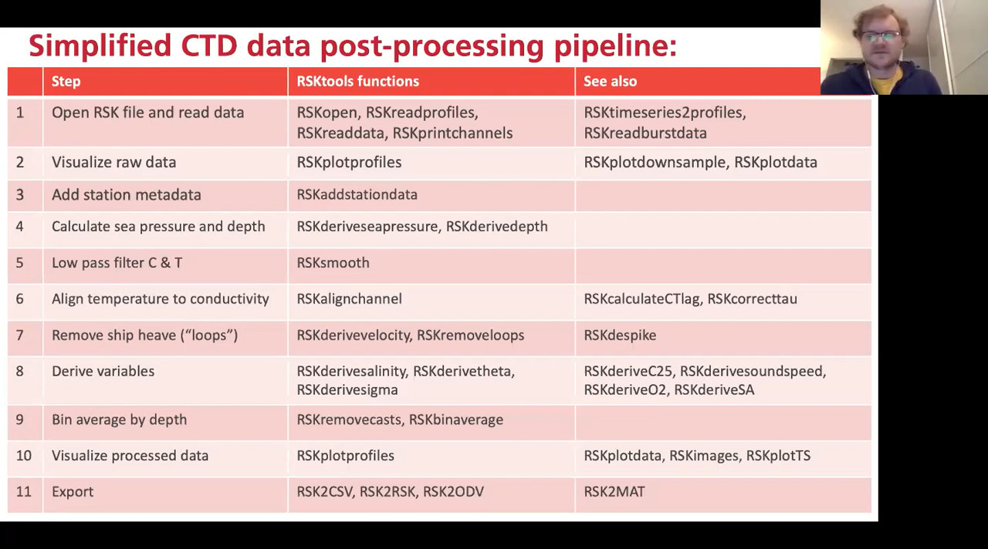
(py)RSKtools

Slide 7
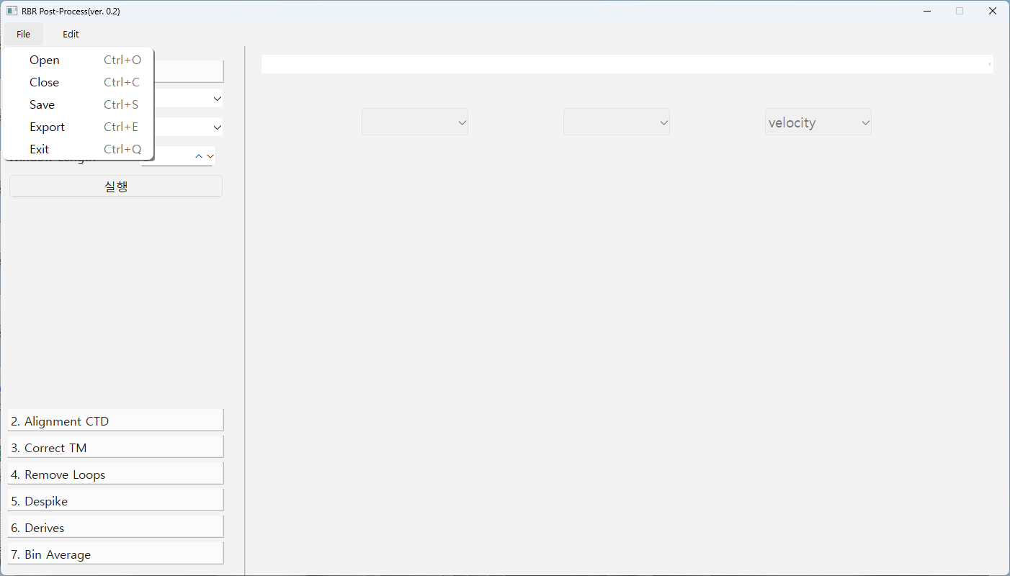

Slide 8
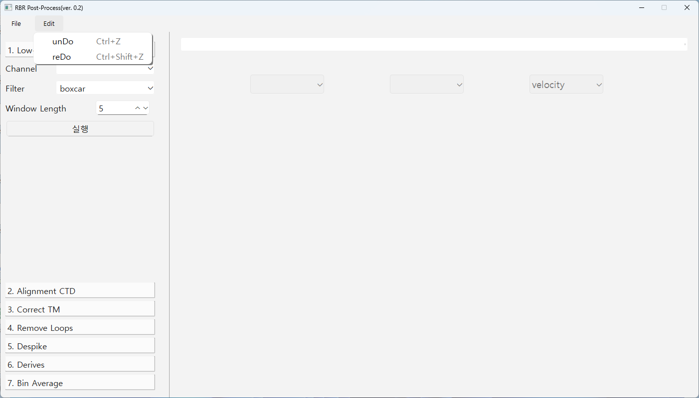
메시지
그림 항목
그림

Slide 9
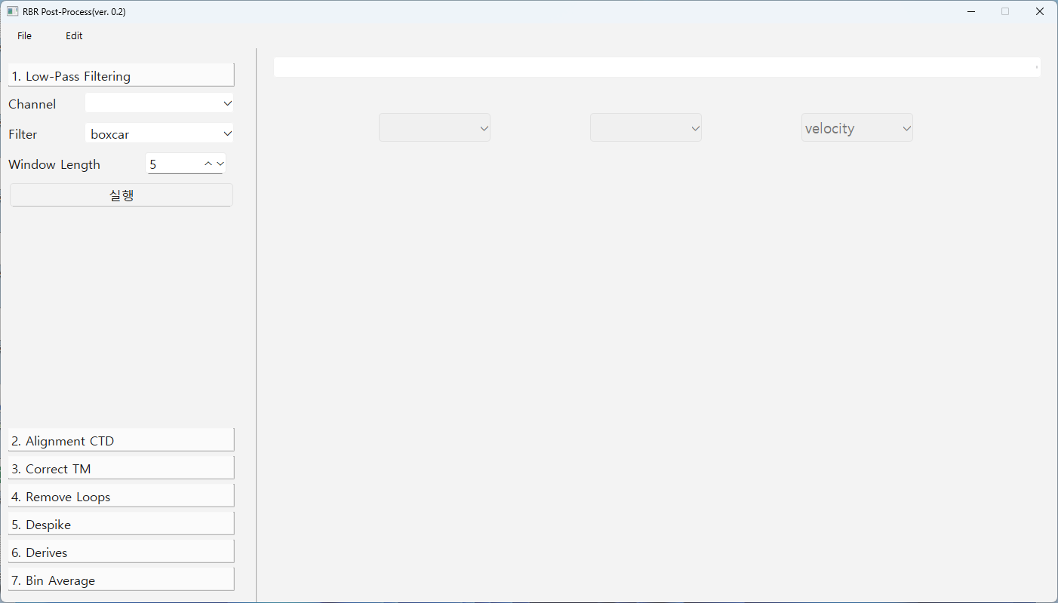
def smooth(self: RSK, channels: Union[str, Collection[str]], filter: str = "boxcar",
profiles: Optional[Union[int, Collection[int]]] = [], direction: str = "both",
windowLength: int = 3,
) -> None:"""Apply a low pass filter on the specified channel(s).
Args:
channels (Union[str, Collection[str]]): longname of channel to filter. Can be a single
channel, or a list of multiple channels.
filter (str, optional): the weighting function, "boxcar", "triangle", or "median".
profiles (Union[int, Collection[int]], optional): profile number(s).
direction (str, optional): cast direction of either "up", "down", or "both".
windowLength (int, optional): the total size of the filter window. Must be odd.
Edge effects are handled by mirroring the original time series.
The ``windowLength`` argument determines the degree of smoothing.
If ``windowLength`` = 5; the filter is composed of two samples from either side of
the evaluated sample and the sample itself. ``windowLength`` must be odd to
centre the average value within the window.
The median filter is less sensitive to extremes (best for spike removal), whereas the
boxcar and triangle filters are more effective at noise reduction and smoothing.
Example:
>>> rsk.smooth(channels=["temperature", "salinity"], windowLength=17)
자료항목
필터링방법
Window 개수

Slide 10
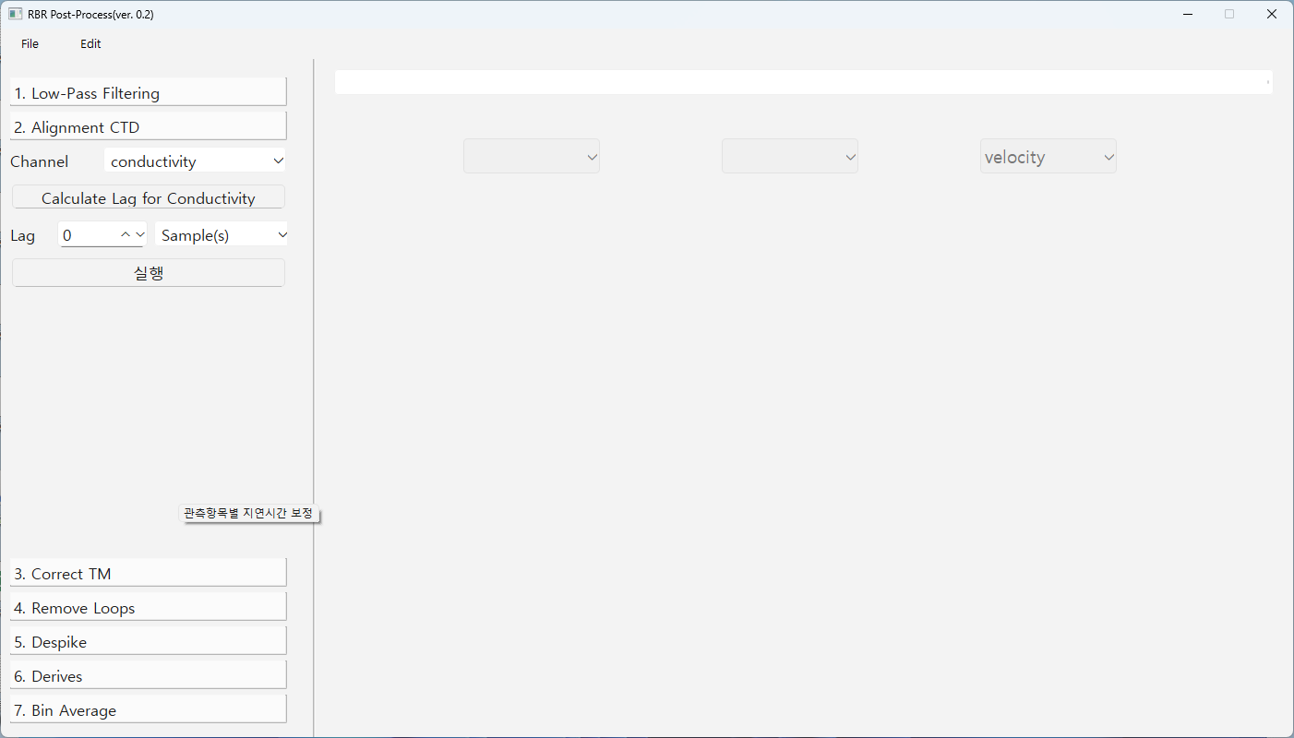
def alignchannel(self: RSK, channel: str, lag: Union[float, Collection[float]],
profiles: Optional[Union[int, Collection[int]]] = [], direction: str = "both",
shiftfill: str = "zeroorderhold", lagunits: str = "samples",
) -> None:"""Align a channel using a specified lag.
Args:
channel (str): longName of the channel to align (e.g. temperature)
lag (Union[float, Collection[float]]): lag to apply to the channel, negative lag
shifts the channel backwards in time (earlier), while a positive lag shifts the
channel forward in time (later)
profiles (Union[int, Collection[int]], optional): profile number(s).
Defaults to None (all available profiles)
direction (str, optional): cast direction of either "up", "down", or "both".
Defaults to "both".
shiftfill (str, optional): shift fill treatment of "zeroorderhold", "nan", or "mirror".
Defaults to "zeroorderhold".
lagunits (str, optional): lag units, either "samples" or "seconds". Defaults to "samples".
Example:
>>> rsk.alignchannel(channel="temperature", lag=2, profiles=range(0,3))
>>> rsk.alignchannel(channel="dissolved_o2_concentration", lag=[2,1,-1,0], profiles=range(0,3))
>>> lag = rsk.calculateCTlag()
>>> rsk.alignchannel(channel="conductivity", lag=lag)
자료항목
반응지연 계산
반응지연
단위

Slide 11
calculateCTlag(self: 'RSK', seapressureRange: 'Optional[Tuple[float, float]]' = None,
profiles: 'Optional[Union[int, Collection[int]]]' = [], direction: 'str' = 'both',
windowLength: 'int' = 21) -> 'List[float]'
Args:
seapressureRange (Tuple[float, float], optional): limits of the sea_pressure range used
to obtain the lag.
Specify as a two-element tuple, [seapressureMin, seapressureMax]. Default is None.
profiles (Union[int, Collection[int]], optional): profile number(s). Defaults to None.
direction (str, optional): cast direction of either "up", "down", or "both". Defaults to
"both".
windowLength (int, optional): length of the filter window used for the reference
salinity. Defaults to 21.
Returns:
List[float]: optimal lag of conductivity for each profile. These can serve as inputs
into :meth:`.RSK.alignchannel`.
Estimates the optimal conductivity time shift relative to temperature in order to
minimise salinity spiking.
The algorithm works by computing the salinity for conductivity lags of -20 to 20
samples at 1 sample increments.
Example:
>>> rsk.calculateCTlag(seapressureRange=[0, 1.0])
... # Optional arguments
... rsk.calculateCTlag(seapressureRange=[0, 1.0], profiles=1, direction="up", windowLength=23)
자료항목
반응지연 계산
반응지연
단위

Slide 12
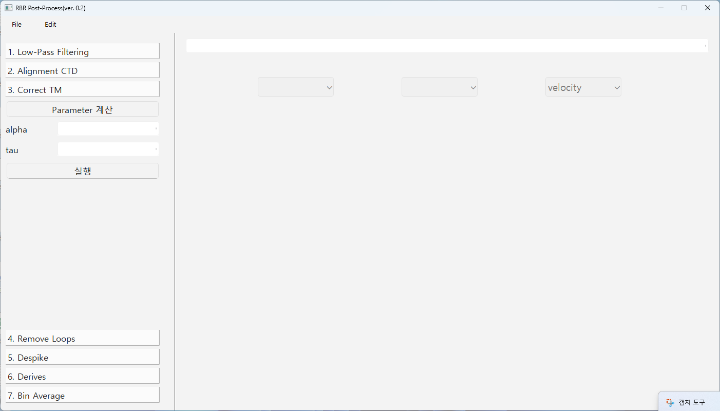
def correctTM(self: RSK, alpha: float, beta: float, gamma: float = 1.0,
profiles: Optional[Union[int, Collection[int]]] = [], direction: str = "both",
) -> None: """Apply a thermal mass correction to conductivity using the model of
Lueck and Picklo (1990).
Args:
alpha (float): volume-weighted magnitude of the initial fluid thermal anomaly.
beta (float): inverse relaxation time of the adjustment.
gamma (float, optional): temperature coefficient of conductivity (dC/dT). Defaults to 1.0.
profiles (Union[int, Collection[int]], optional): profile number(s). Defaults to [].
direction (str, optional): cast direction of either "up", "down", or "both".
Defaults to "both".
Applies the algorithm developed by Lueck and Picklo (1990) to minimize the effect of
conductivity cell thermal mass on measured conductivity. Conductivity cells
exchange heat with the water as they travel through temperature gradients. The
heat transfer changes the water temperature and hence the measured conductivity.
This effect will impact the derived salinity and density in the form of sharp spikes and
even a bias under certain conditions.
Example:
>>> rsk.correctTM(alpha=0.04, beta=0.1)
인하대 방식 사용

Slide 13
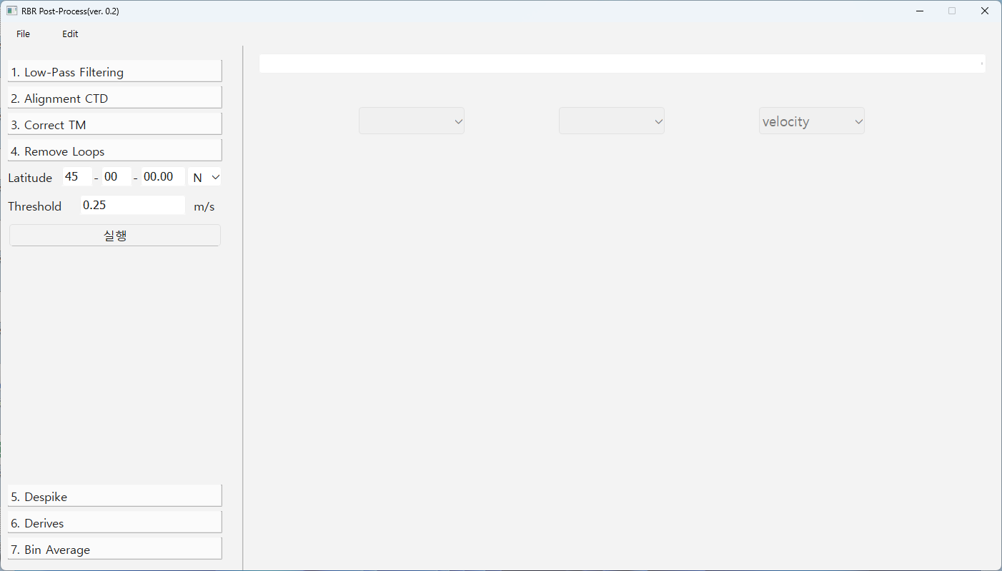
def removeloops(self: RSK, profiles: Optional[Union[int, Collection[int]]] = [],
direction: str = "both", threshold: float = 0.25,
) -> List[int]:
"""Remove data with a profiling rate less than a threshold and with reversed pressure (loops).
Args:
profiles (Union[int, Collection[int]], optional): profile number(s). Defaults to.
direction (str, optional): cast direction of either "up", "down", or "both". Defaults to "both".
threshold (float, optional): minimum speed at which the profile must be taken.
Defaults to 0.25 m/s.
Flags and replaces pressure reversals or profiling slowdowns with NaNs in the data
field of this RSK instance and returns the index of these samples. Variations in
profiling rate are caused by, for example, profiling from a vessel in rough seas
with a taut wire, or by lowering a CTD hand over hand.
**NOTE**:
The input RSK must contain a ``depth`` channel. See :meth:`RSK.derivedepth()`.
Example:
>>> loops = rsk.removeloops(direction= "down", threshold= 0.1)
위도
한계속력

Slide 14
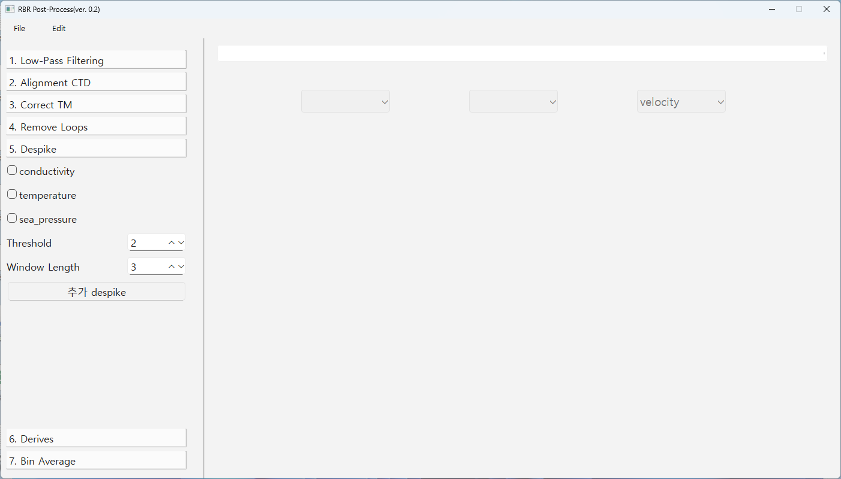
def despike(self: RSK, channels: str, profiles: Optional[Union[int, Collection[int]]] = [],
direction: str = "both", threshold: int = 2, windowLength: int = 3,
action: str = "nan",
) -> dict:
"""Despike a time series on a specified channel.
Args:
channels (str): longname of channel to despike (e.g., temperature, or salinity, etc).
profiles (Union[int, Collection[int]], optional): profile number(s). Defaults to.
direction (str, optional): cast direction of either "up", "down", or "both". Defaults to
"both".
threshold (int, optional): amount of standard deviations to use for the spike criterion.
Defaults to 2.
windowLength (int, optional): total size of the filter window. Must be odd.
Defaults to 3.
action (str, optional): action to perform on a spike. Given "nan", spikes are replaced
with NaN. Other options are "replace", whereby spikes are replaced with the
corresponding reference value, and "interp" whereby spikes are replaced with
values calculated by linearly interpolating from the neighbouring points.
Defaults to "nan".
Example:
>>> spikes = rsk.despike(channel="Temperature", profiles=range(0, 4), direction="down",
threshold=4.0, windowLength=11, action="nan")
항목
표준편차
Window 개수

Slide 15
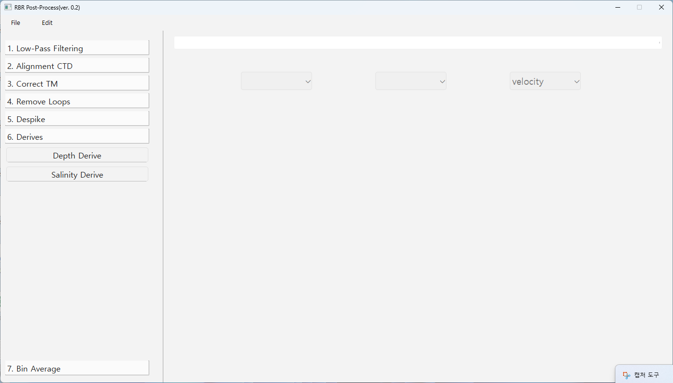
def derivesalinity(self: RSK, seawaterLibrary: str = "TEOS-10") -> None:
"""Calculate practical salinity.
Args:
seawaterLibrary (str, optional): which underlying library this method should utilize. Current support includes: "TEOS-10". Defaults to "TEOS-10".
Calculates salinity from measurements of conductivity, temperature, and sea pressure,
using the TEOS-10 GSW function ``gsw_SP_from_C``.
It requires the current RSK instance to be populated with conductivity, temperature,
and pressure data.
If there is already a salinity channel present, this method replaces the values with a
new calculation of salinity.
If sea pressure is not present, this method calculates it with the default atmospheric
pressure, usually 10.1325 dbar.
Example:
>>> rsk.derivesalinity()
... # Optional arguments
... rsk.derivesalinity(seawaterLibrary="TEOS-10")
항목

Slide 16
def derivedepth(self: RSK, latitude: float = 45.0, seawaterLibrary: str = "TEOS-10") -> None:
"""Calculate depth from pressure.
Args:
latitude (float, optional): latitude of the pressure measurement in decimal degrees.
Defaults to 45.0.
seawaterLibrary (str, optional): which underlying library this method should utilize. Current support includes: "TEOS-10". Defaults to "TEOS-10".
Calculates depth from pressure.
If there is already a depth channel present, this method replaces the values with the
new calculation of depth.
If sea pressure is not present in the current RSK instance, it is calculated with the
default atmospheric pressure (10.1325 dbar)
Example:
>>> rsk.derivedepth()
... # Optional arguments
... rsk.derivedepth(latitude=45.34, seawaterLibrary="TEOS-10")
항목

Slide 17
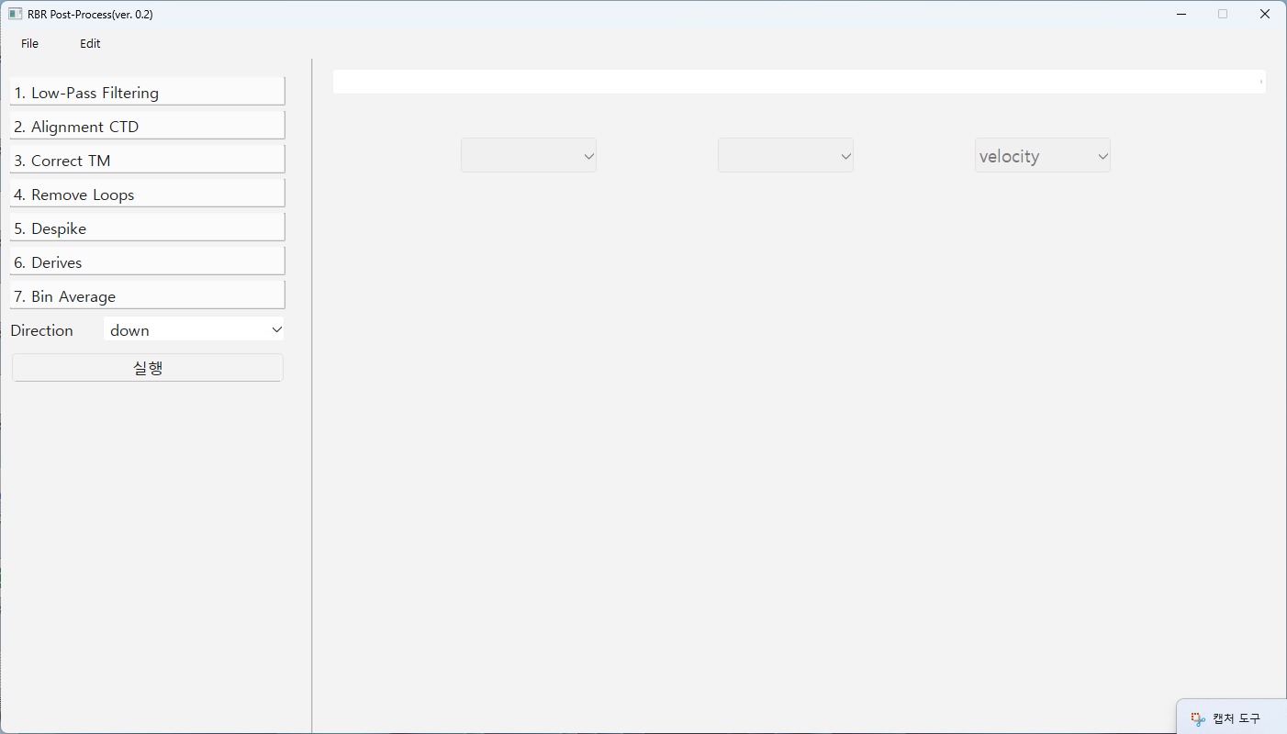
def binaverage( self: RSK, profiles: Optional[Union[int, Collection[int]]] = [],
direction: str = "down", binBy: str = "sea_pressure", binSize: Union[float,
Collection[float]] = 1.0, boundary: Union[float, Collection[float]] = [],
) -> npt.NDArray:
"""Average the profile data by a quantized reference channel.
Args:
profiles (Union[int, Collection[int]], optional): profile number(s). Defaults to
direction (str, optional): cast direction of either "up" or "down". Defaults to "down".
binBy (str, optional): reference channel that determines the samples in each bin, can
be ``timestamp`` or any channel. Defaults to "sea_pressure".
binSize (Union[float, Collection[float]], optional): size of bins in each regime. Defaults
to 1.0, denoting 1 unit of binBy channel (e.g., 1 second when binBy is time).
boundary (Union[float, Collection[float]], optional): first boundary crossed in the
direction selected of each regime, in the same units as binBy. Must have
len(boundary) == len(binSize) or one greater. Defaults to [] (entire range).
The bins are specified using two arguments: ``binSize`` and ``boundary``.
>>> rsk.binaverage(direction="down", binSize=1.0, boundary=0.5)
>>> samplesinbin = rsk.binaverage(direction="down", binBy="Depth", binSize=[10.0, 50.0], boundary=[10.0, 50.0, 200.0])
>>> samplesinbin = rsk.binaverage(binBy="time", binSize=600.0)
Upcast 또는
downcast

